Slide 1
MACHINE LEARNING APPLIED TO CREDIT CARD FRAUD DETECTION.
STUDENT: David De Vega Martin ddevega@uoc.edu TUTOR: Francesc Julve Lopez.

Slide 2
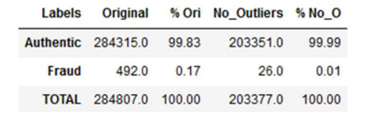
Objectives:
Select and implement a series of machine learning algorithms.
Conduct a comparative study of them.
Obtain a prediction model that determines whether a transaction is legitimate or not.
Dataset:
European Credit Card Fraud dataset. https://www.kaggle.com/datasets/mlg-ulb/creditcardfraud
Variable Composition:
Time
Features: V1- V28
Amount
Class (0 - Authentic, 1- Fraud)

Slide 3
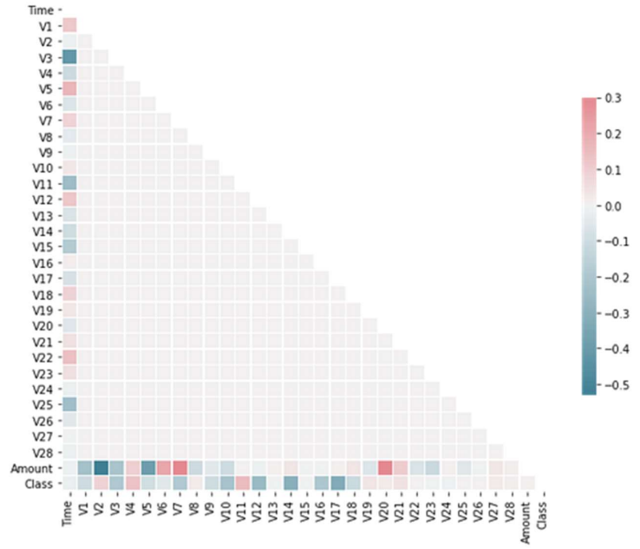
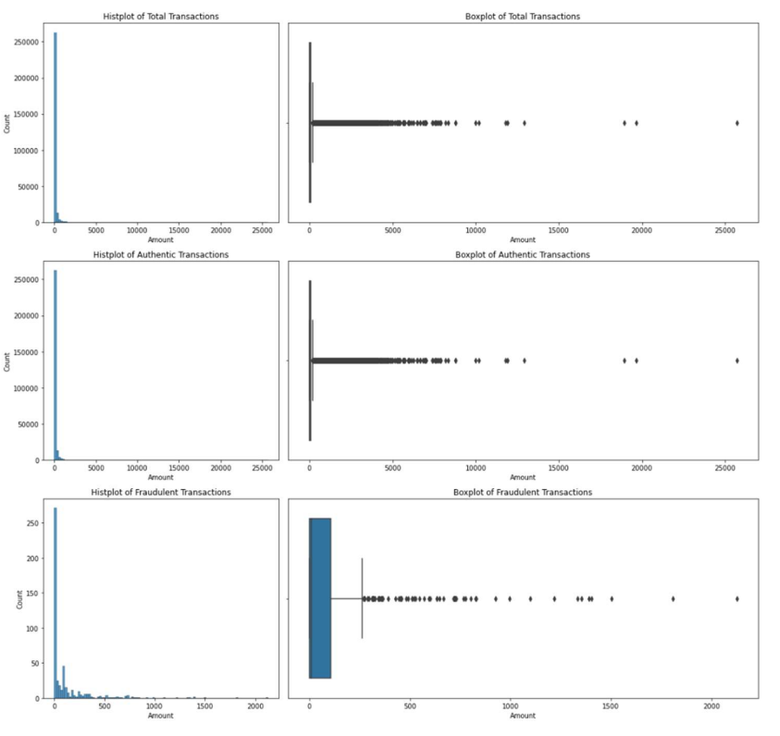
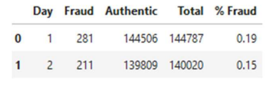
Time: Transactions are recorded in seconds over the course of those 2 days. V1-V28: Processed using PCA to preserve sensitive data. There are no strong correlations. Amount:Significant variation in transaction amounts and a high volume of outliers.

Slide 4
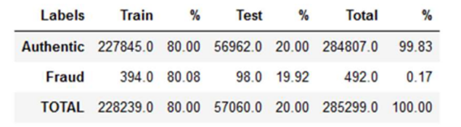
Dataset challenges:
Presence of outliers in the Amount variable: The variable will be scaled using Robust Scaler transformation to center the values around zero and achieve more uniform dispersion.
Presence of skewness in most of the V1-V28 feature variables: Power Transformation from sklearn, specifically the Yeo-Johnson variant, will be applied. This method allows for negative data and helps obtain a distribution closer to normal.
Class imbalance: Oversampling will be applied using SMOTE and ADASYN techniques.

Slide 5
Algorithms and evaluation measures:
Algorithms:
Linear : Logistic Regression.
Boosting: AdaBoost, XGBoost, CatBoost.
Tree Based: Decision Tree, Random Forest.
Based in neural network-based: Multilayer Perceptron (MLP).
Distance Based: K-Near Neighbours (KNN).
Evaluation Measures:
F2 Score: An evaluation metric in binary classification problems that combines precision and recall, giving more importance to recall.
Confusion Matrix: Special attention to the FP (False Positive) and FN (False Negative) classes.

Slide 6
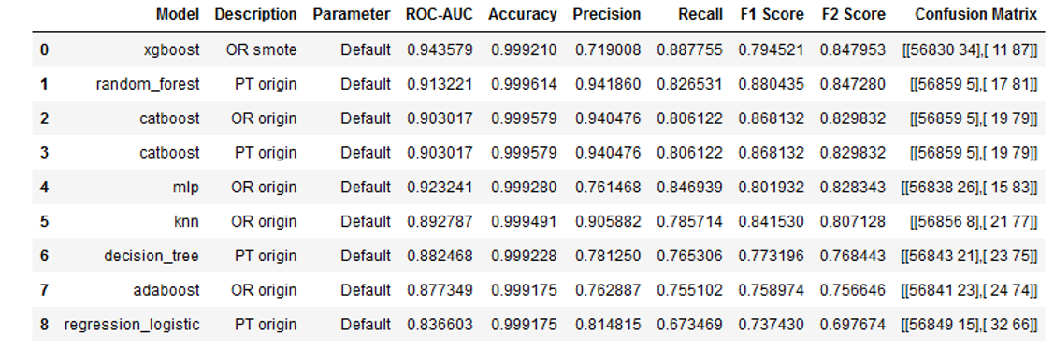
Methodology:
1.- Initial Ranking:Algorithms in their default state. They establish the minimum model value.
2.- Determination of a Key Parameter: For all datasets.
3.- Determination of a Range for That Parameter: To anticipate underfitting and overfitting.
4.- Results are Ordered by F2 Score: Those that do not exceed the minimum value are eliminated.
5.- Selection of the Parameter Value: That achieves the best F2 Score, thus creating the final ranking.

Slide 7
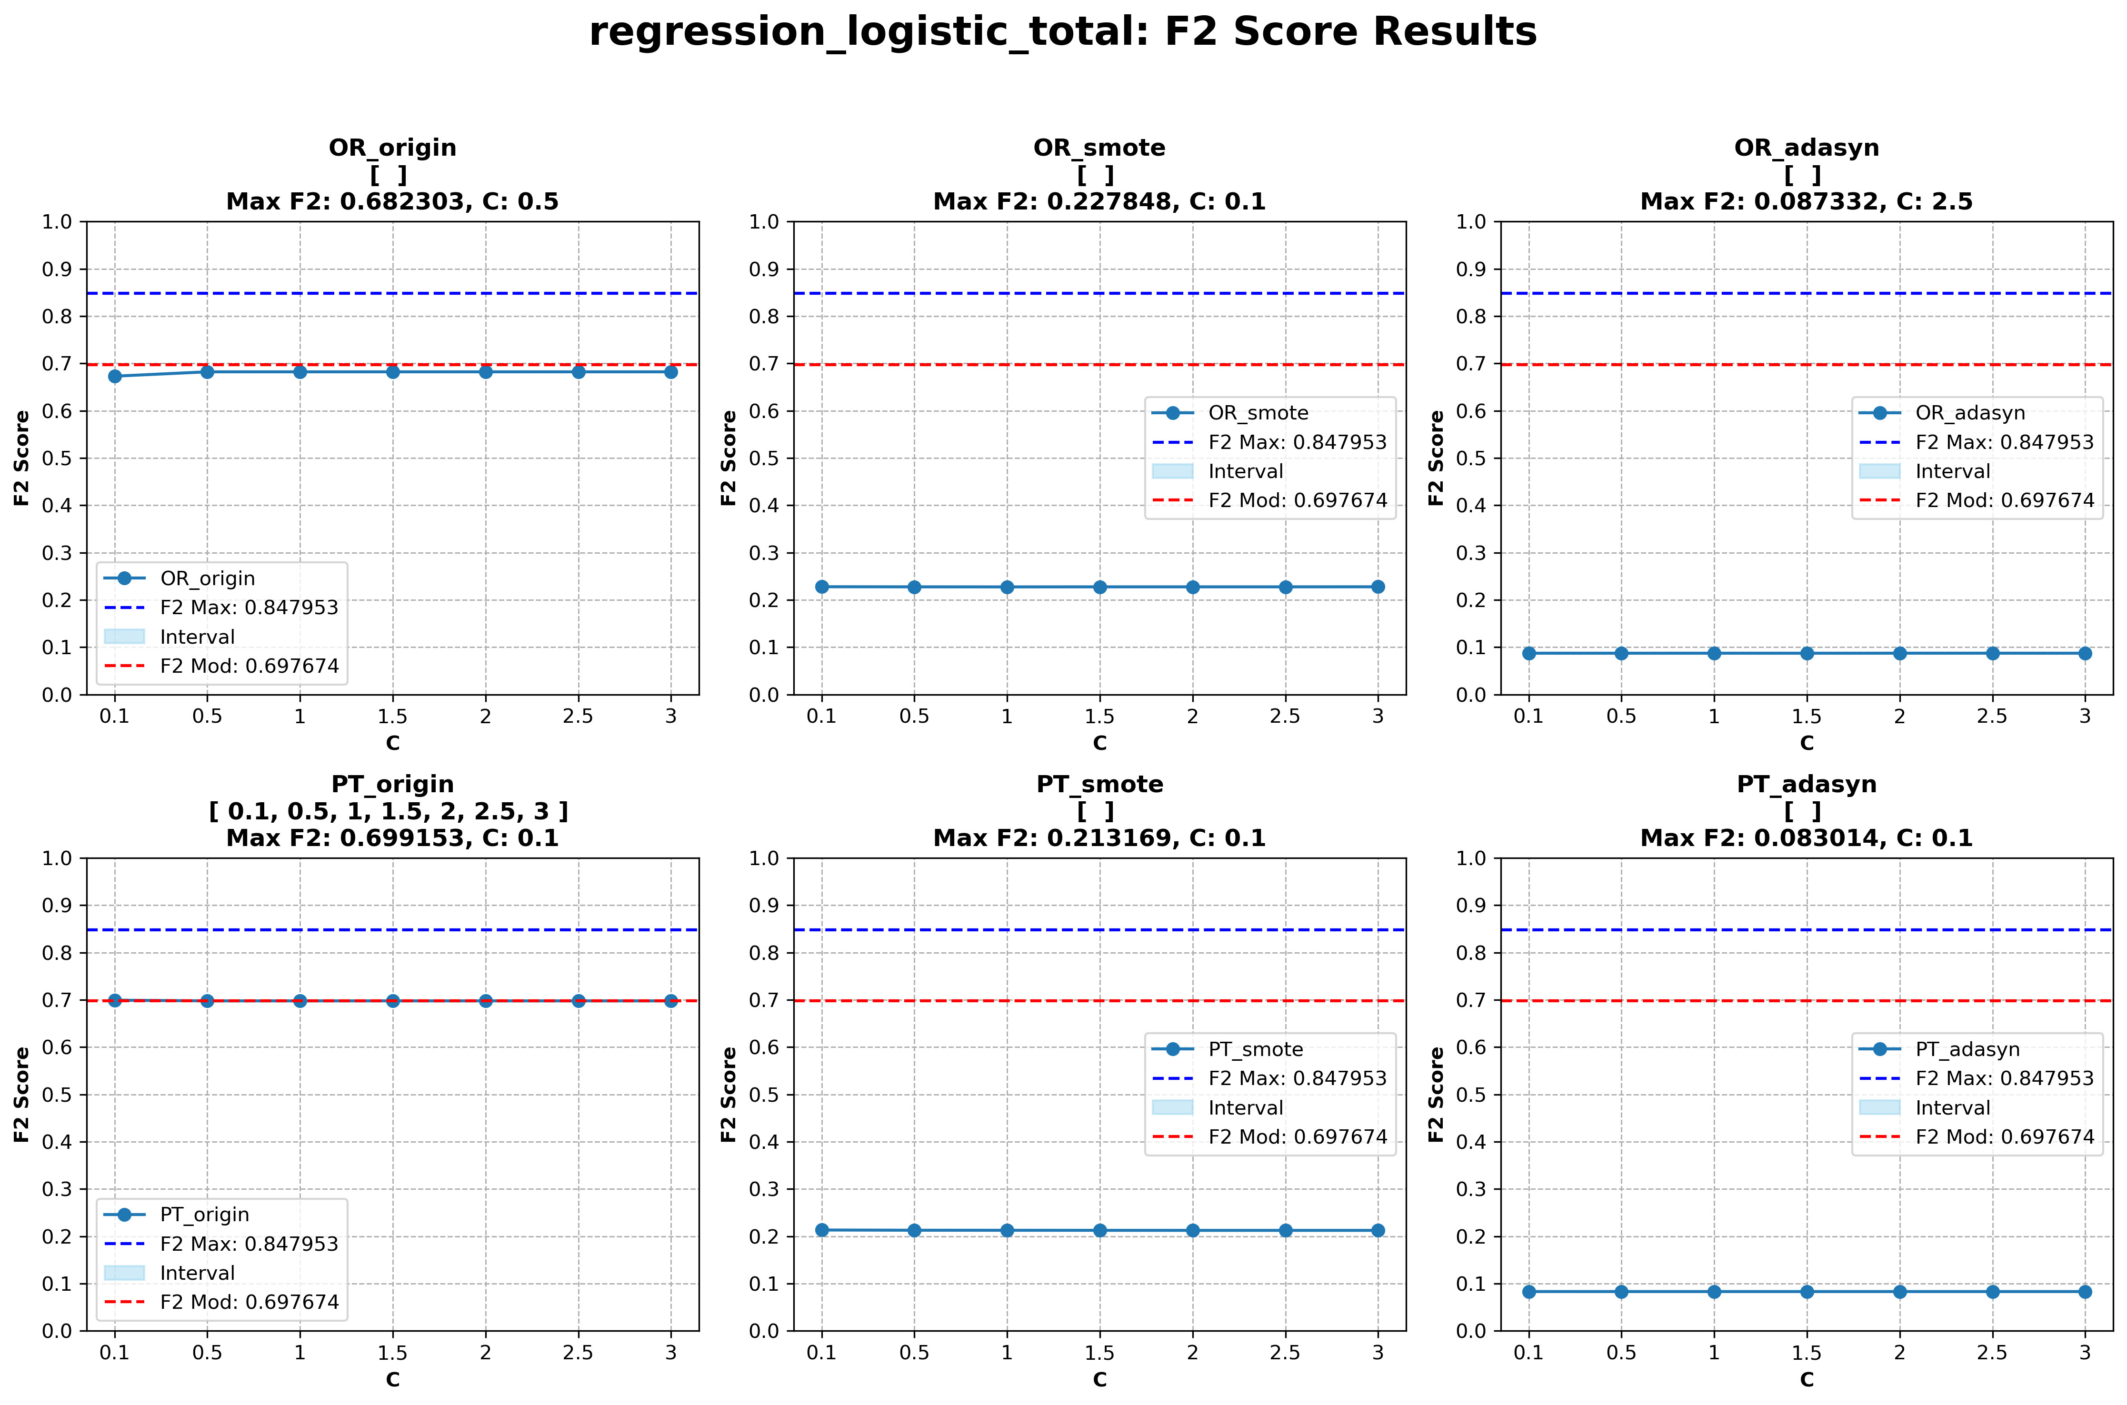
Linear Algorithms: Logistic Regression.
Parameter: C controls regularization or fitting. By default, C = 1.0. C_values = [0.1,0.5,1,1.5,2,2.5,3]

Slide 8
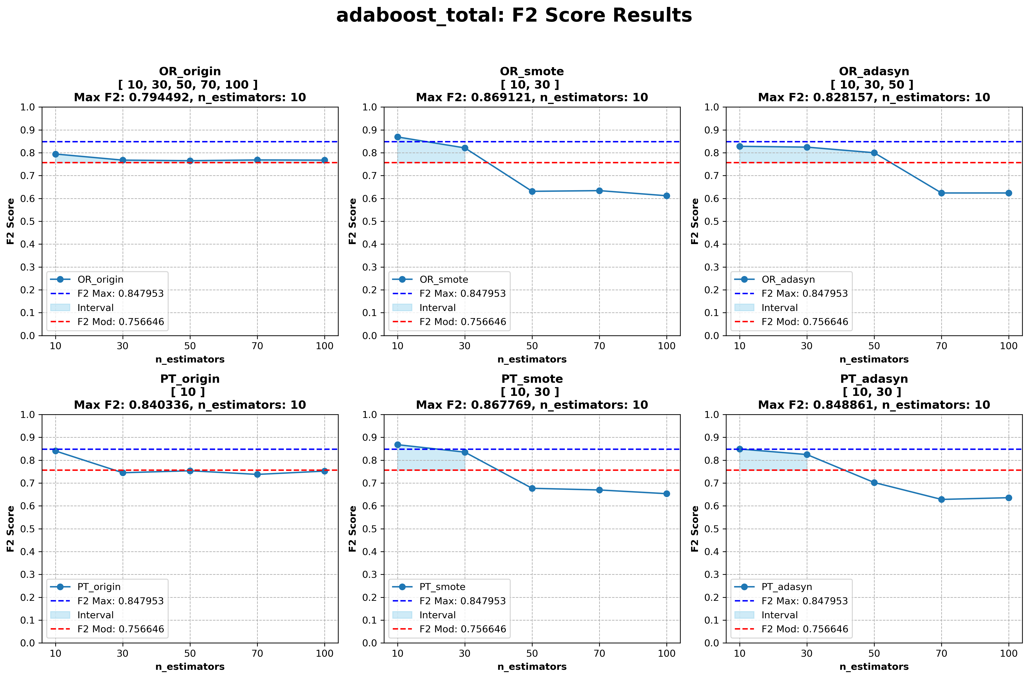
Boosting Algorithms I: AdaBoost.
Parameter: n_estimators is the number of weak classifiers. By default n_estimators = 50, n_estimators = [10, 30, 50, 70, 100]

Slide 9
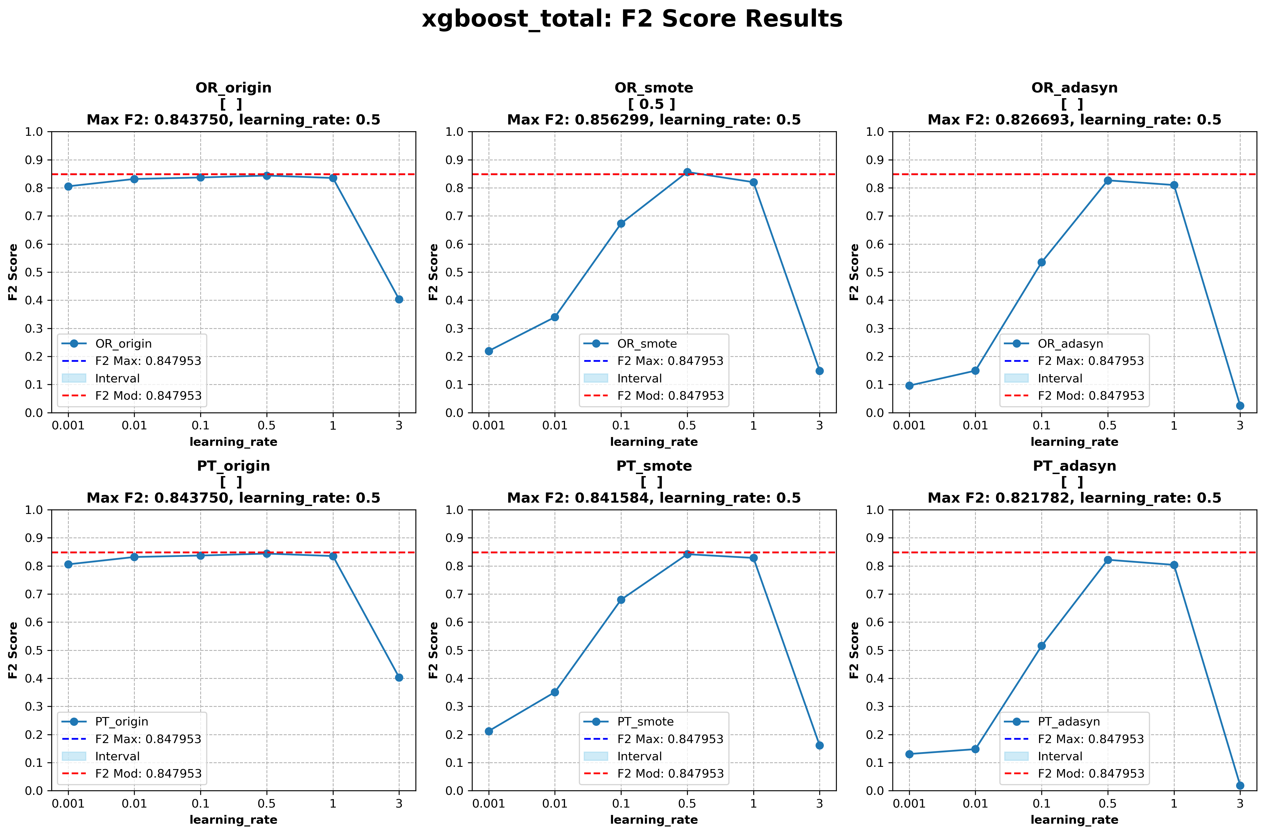
Boosting Algorithms II: XGBoost
Parameter: learning_rate of each tree. By default learning_rate= 0.3, learning_rate = [.001, .01, .1, .5, 1, 3]

Slide 10
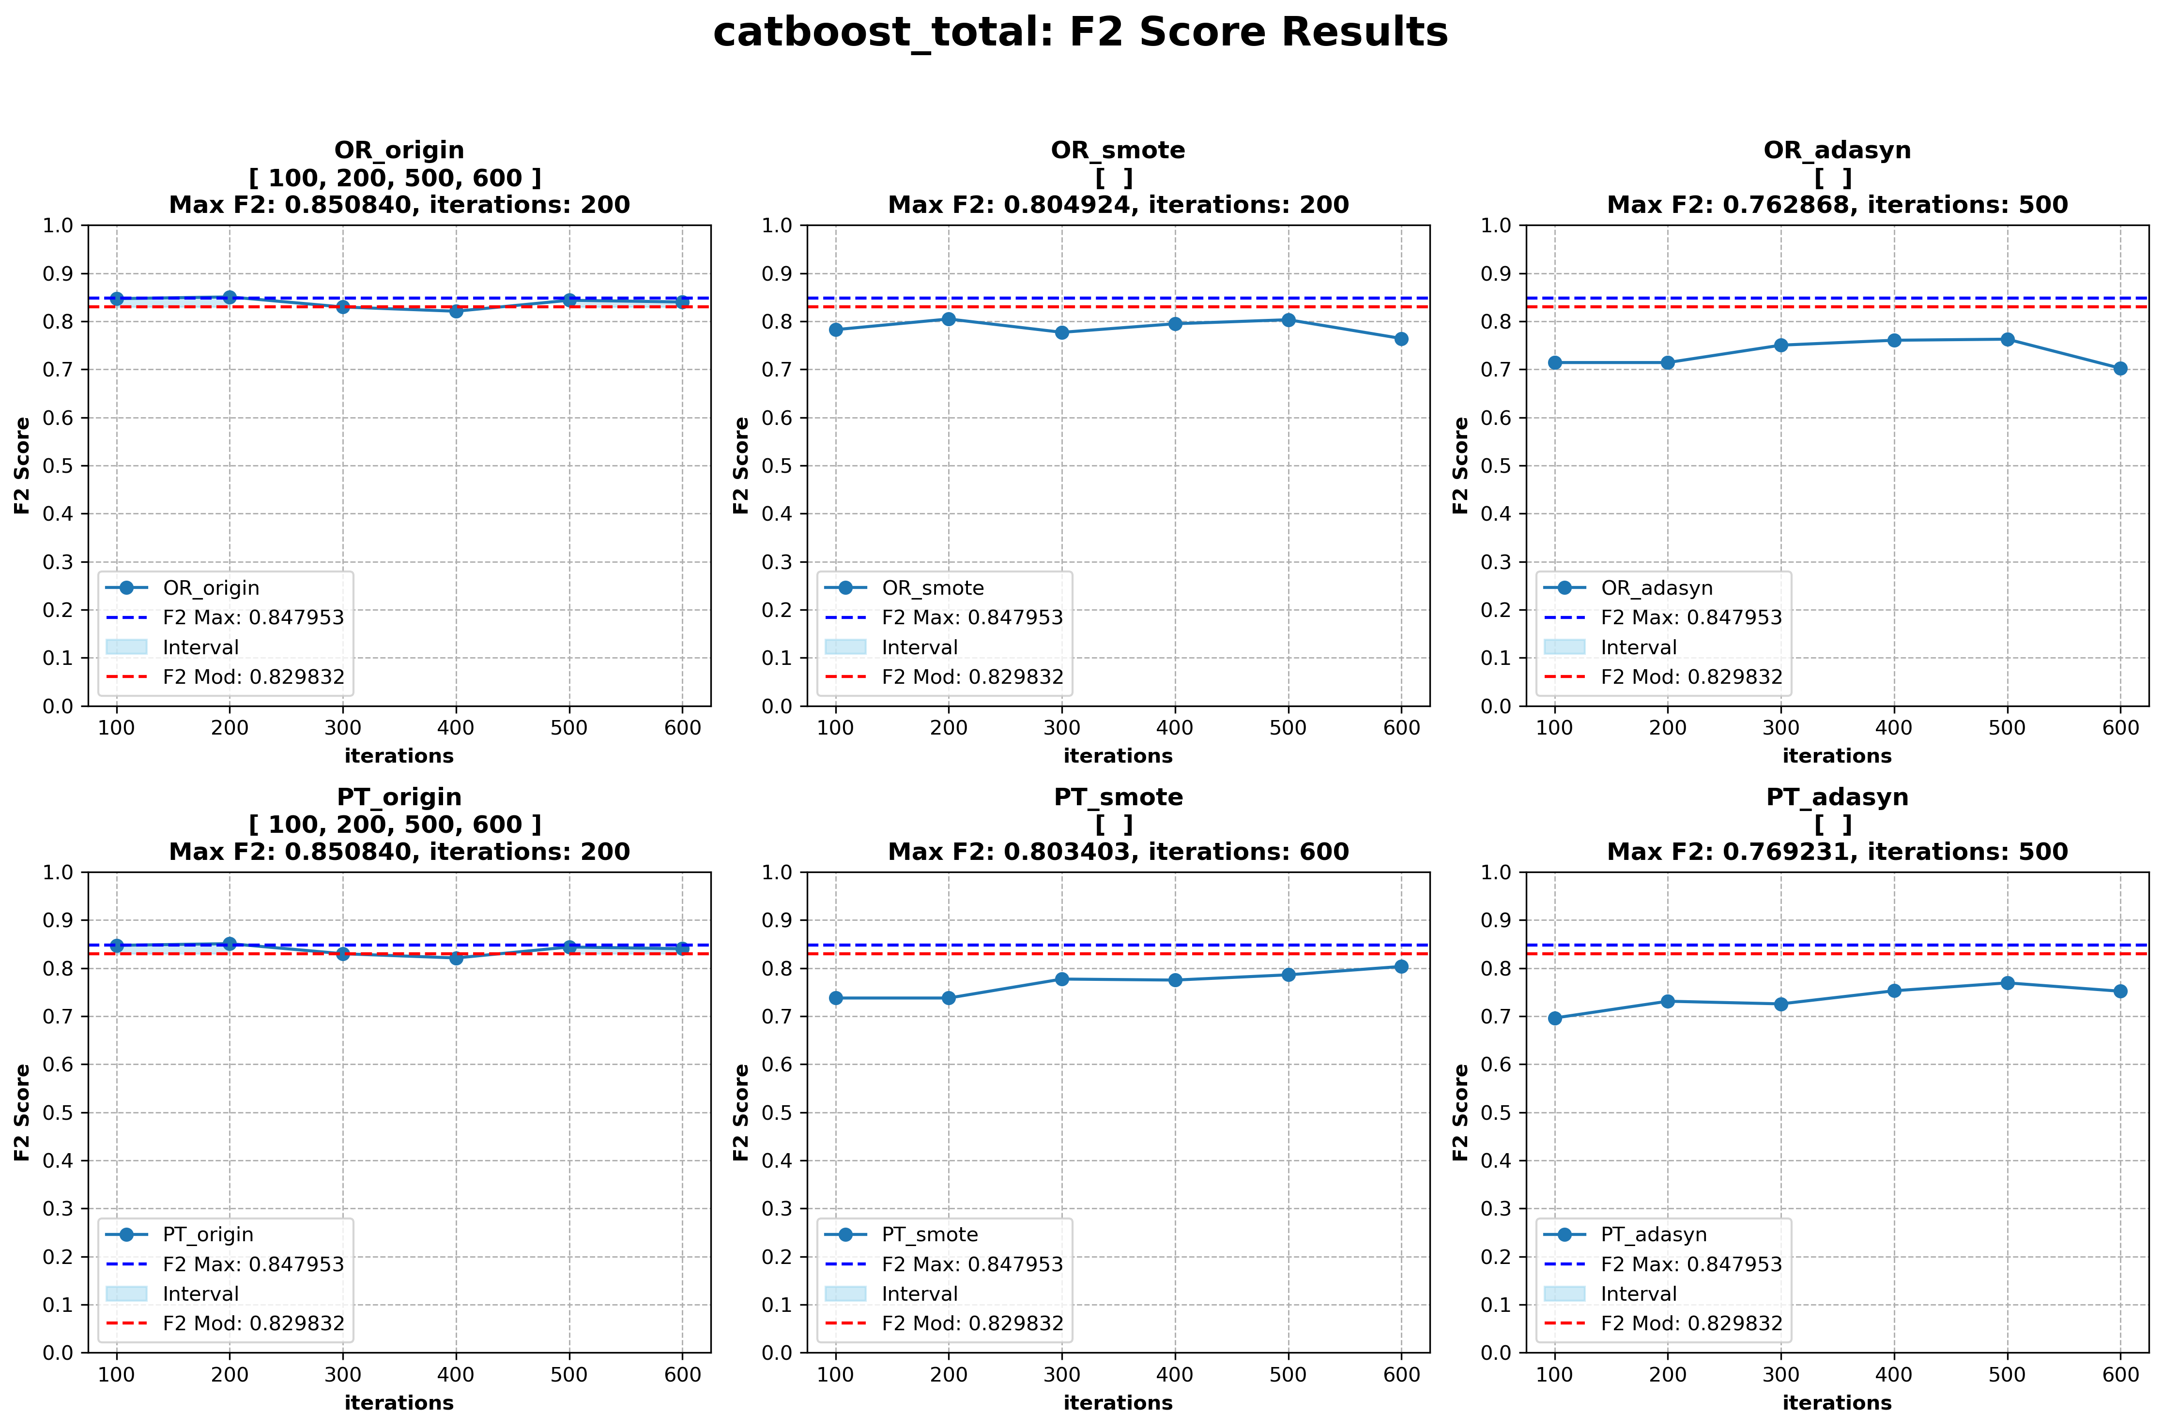
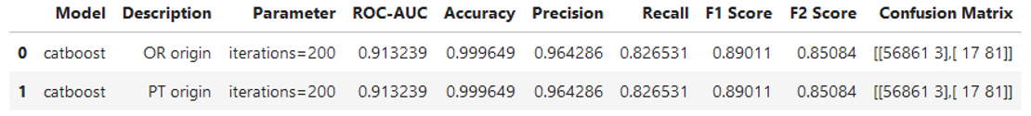
Boosting Algorithm III: CatBoost
Parameters: n_estimators number of tree. By default n_estimators = 1000, n_estimators = [100, 200, 300, 400, 500, 600]

Slide 11
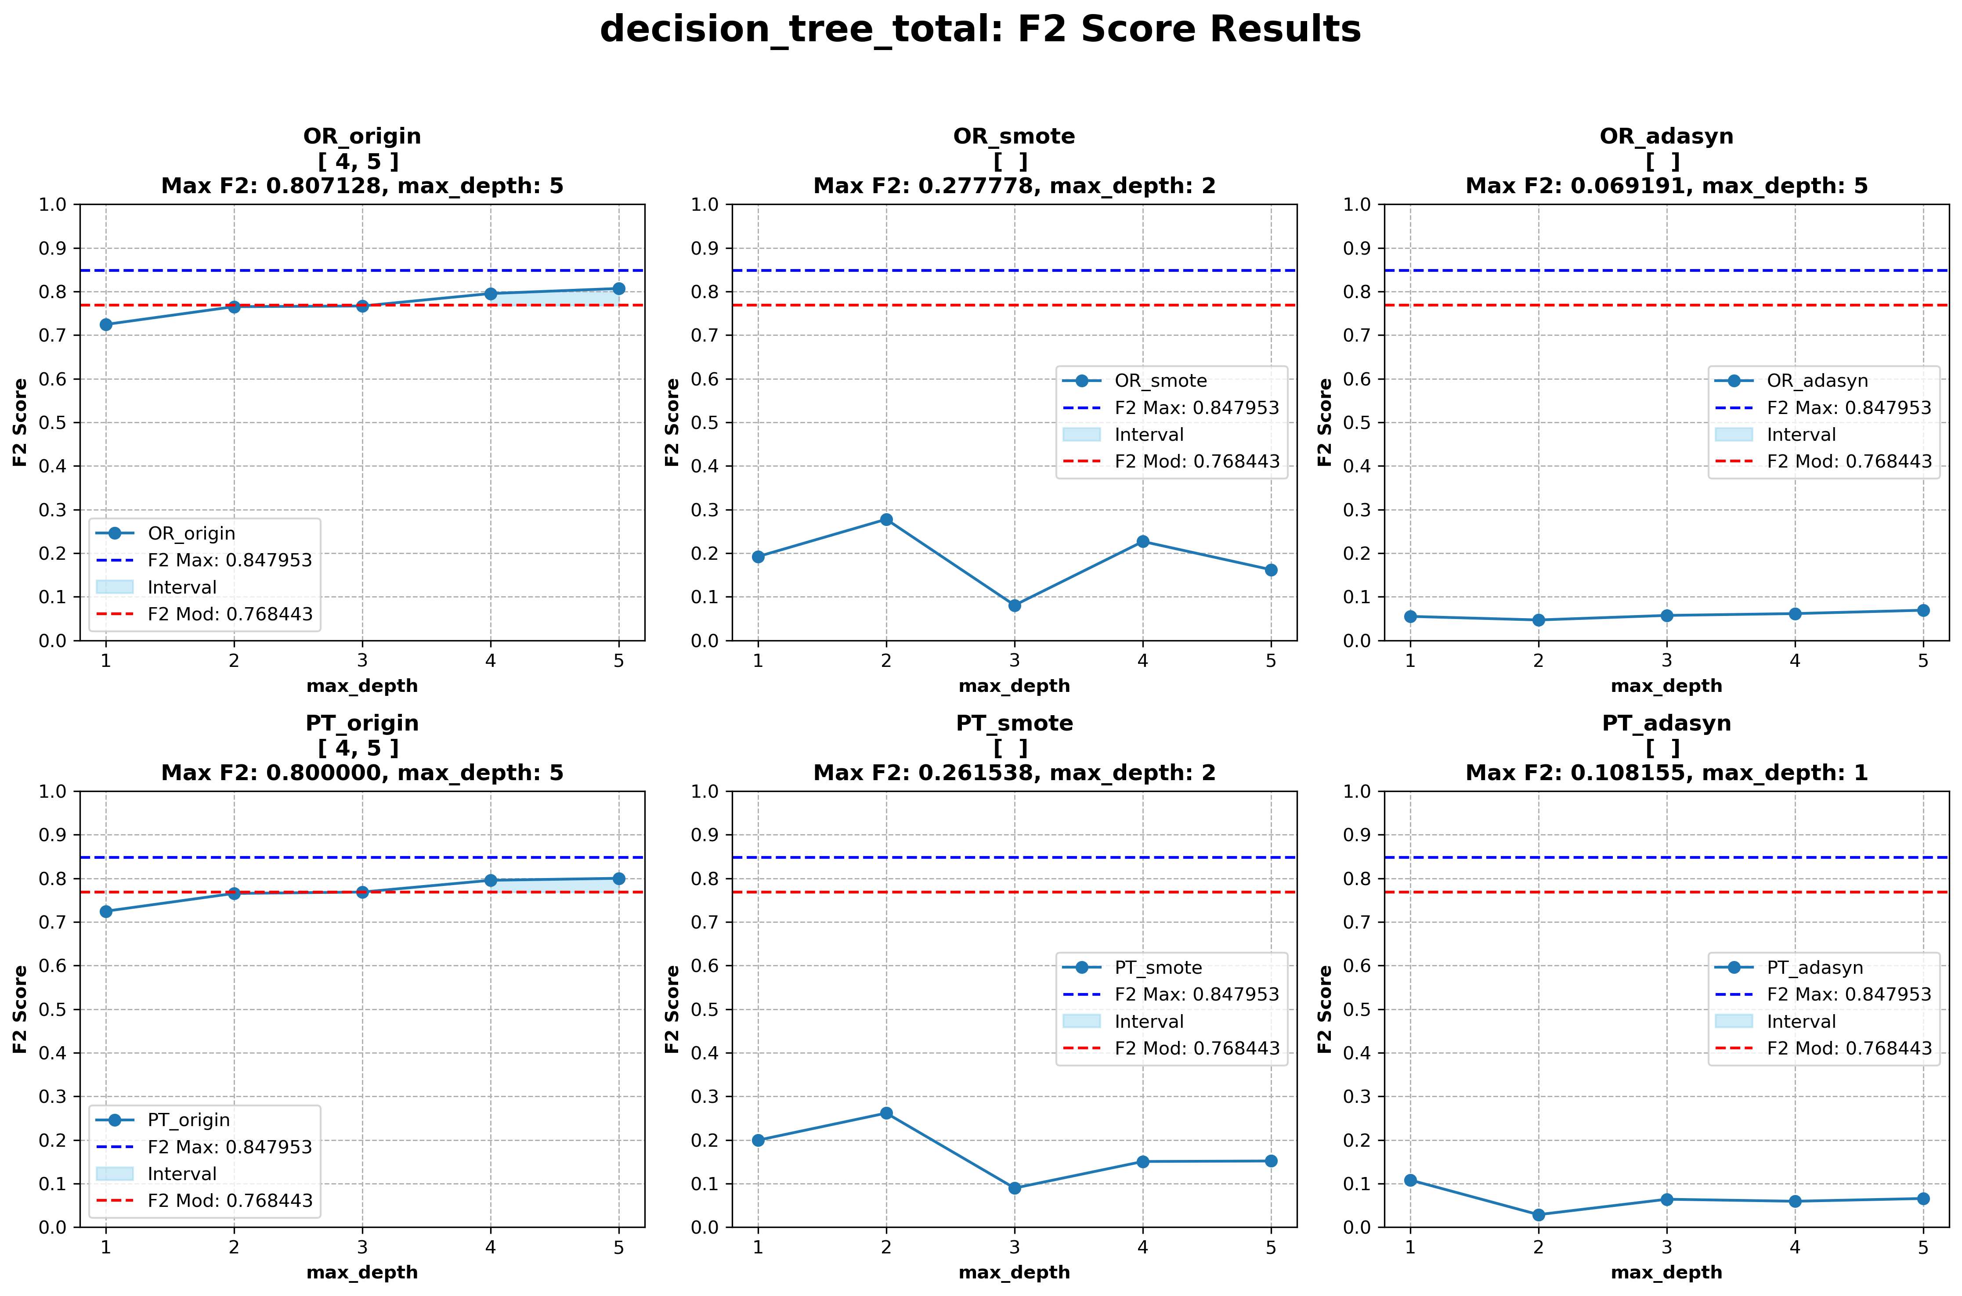
Tree-Based Algorithms I: Decision Tree
Parameter: max_depth of tree. By Default max_depth = None, max_depth = [1 ,2, 3, 4, 5]

Slide 12
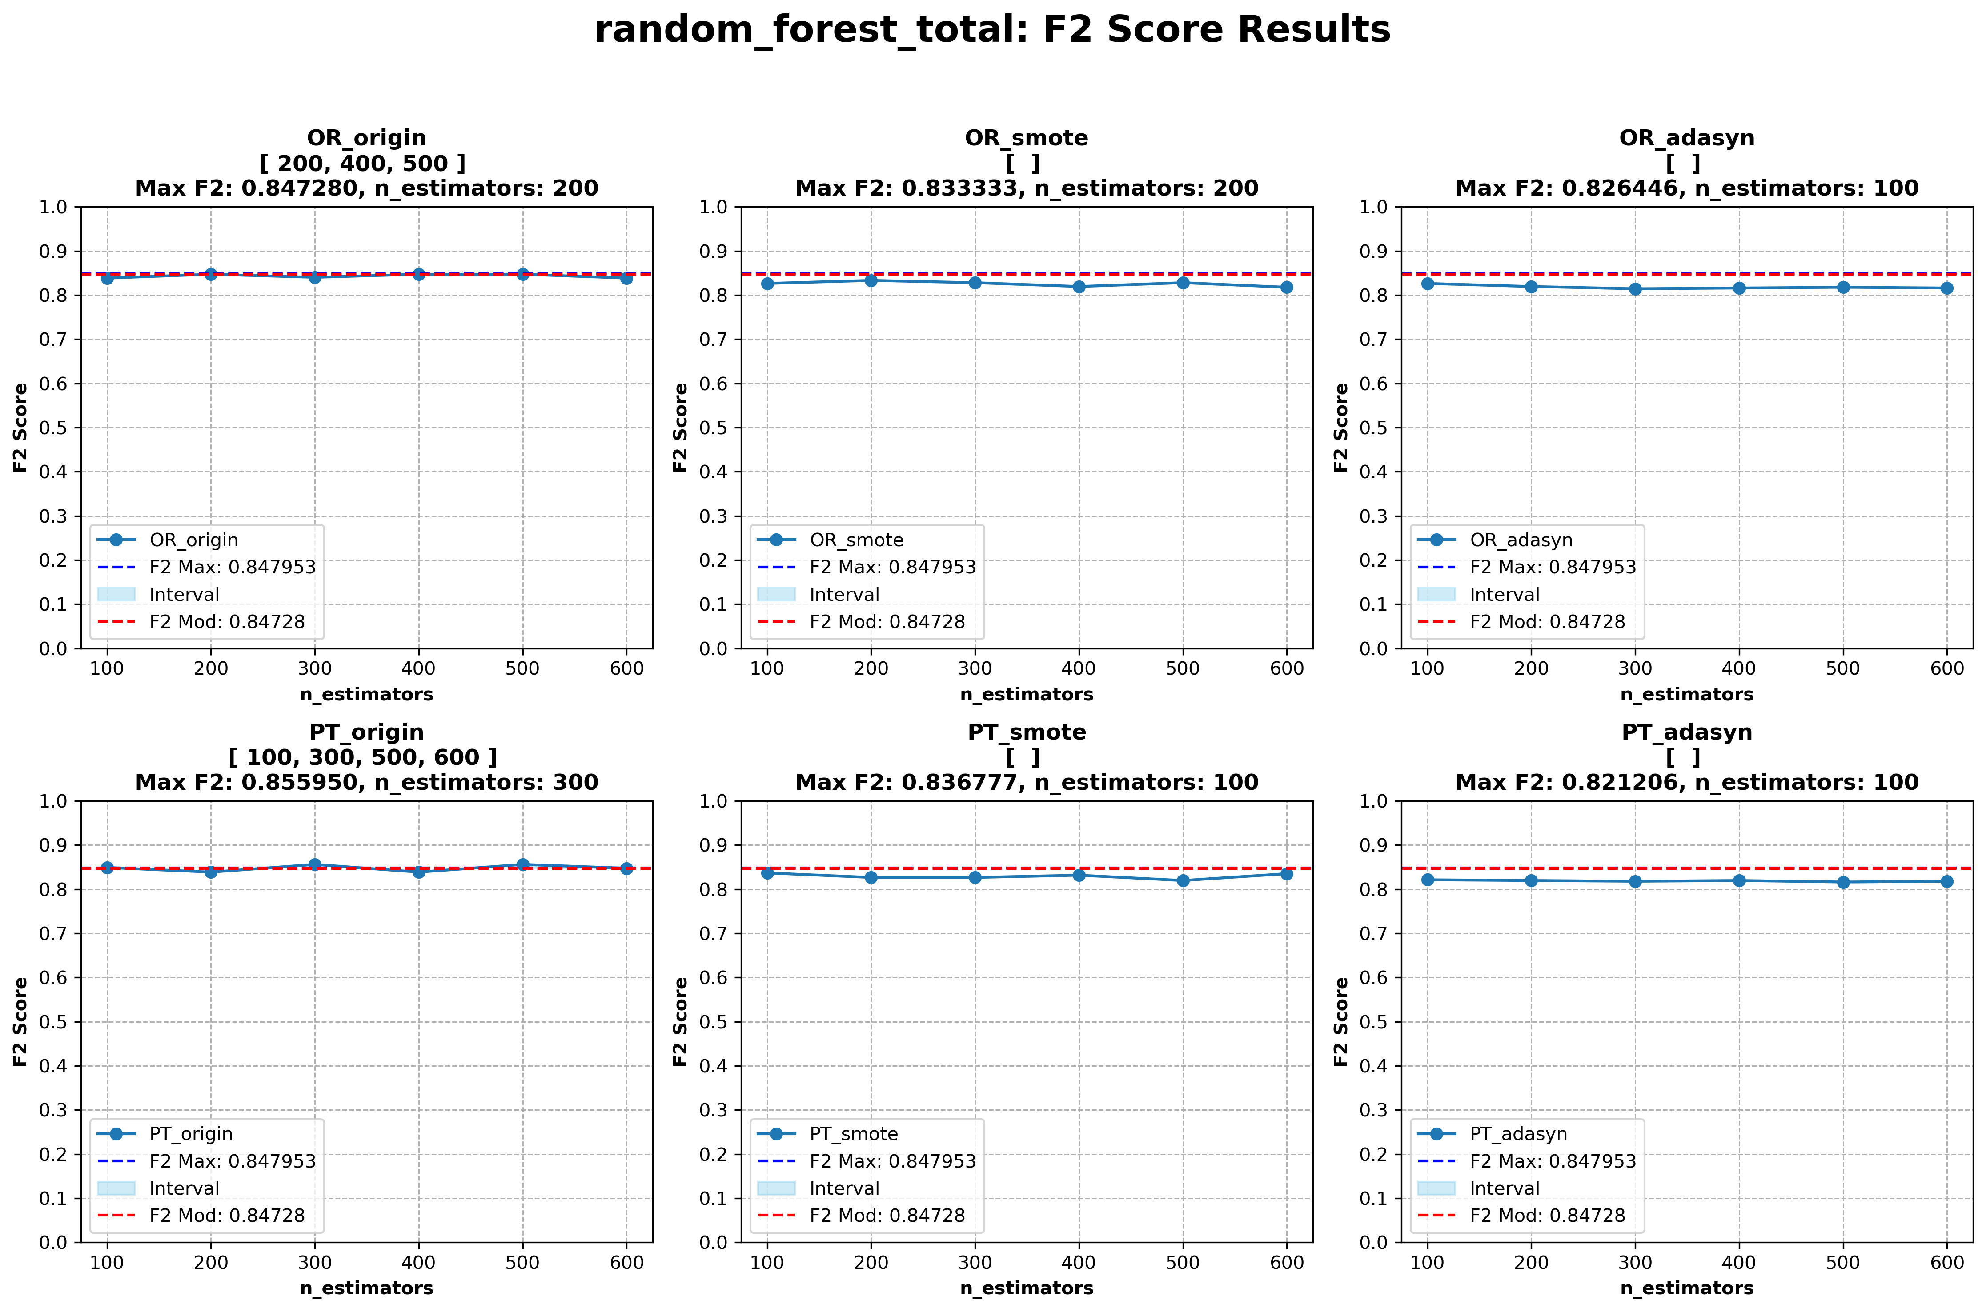
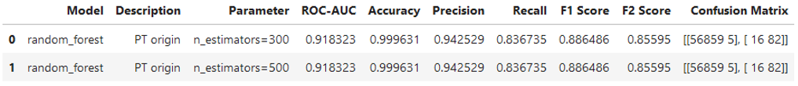
Tree-Based Algorithms II: Random Forest
Parameter: n_estimators máx num of tree arboles. Default n_estimators = 100, n_estimators = [100 , 200, 300, 400, 500, 600]

Slide 13
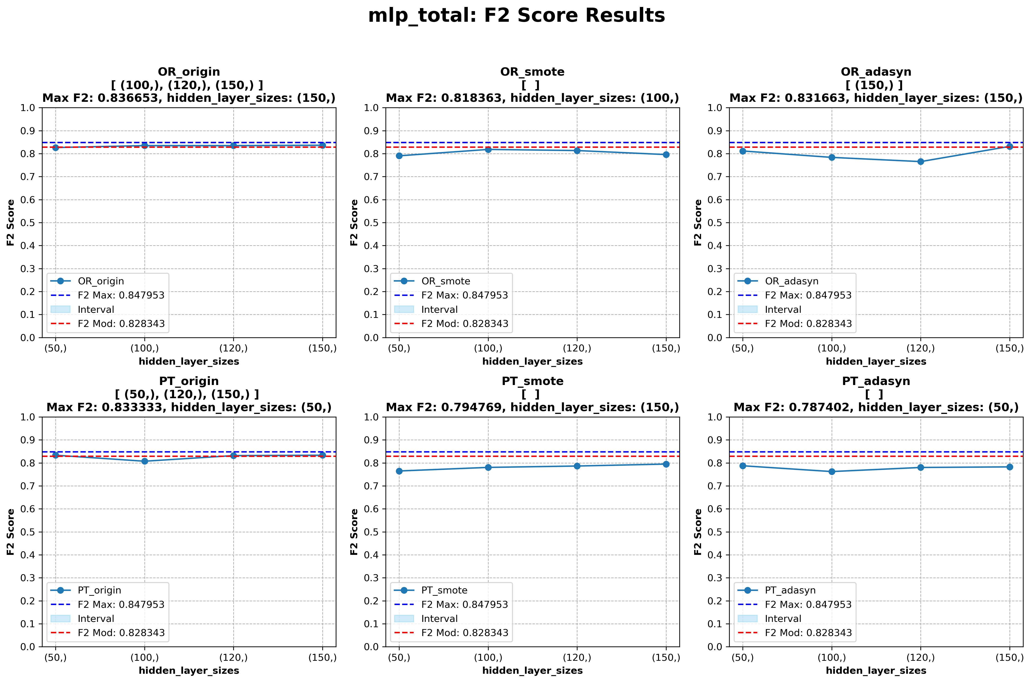
Neural network-based: Multilayer Perceptron (MLP)
Parameter: hidden_layer_sizes. By Default hidden_layer_sizes = 100, hidden_layer_sizes = [(50,), (100,), (120,),(150,)]

Slide 14
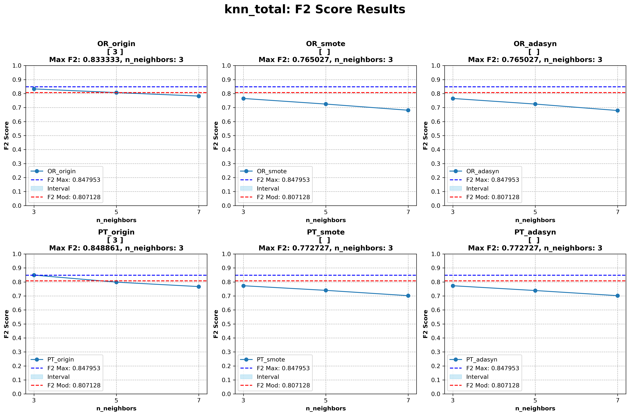
Distance-based: K-Nearest Neighbors (KNN).
Parameter: n_neighbors num of neighbours. By Default n_neighbors = 5, n_neighbors= [3, 5, 7]

Slide 15
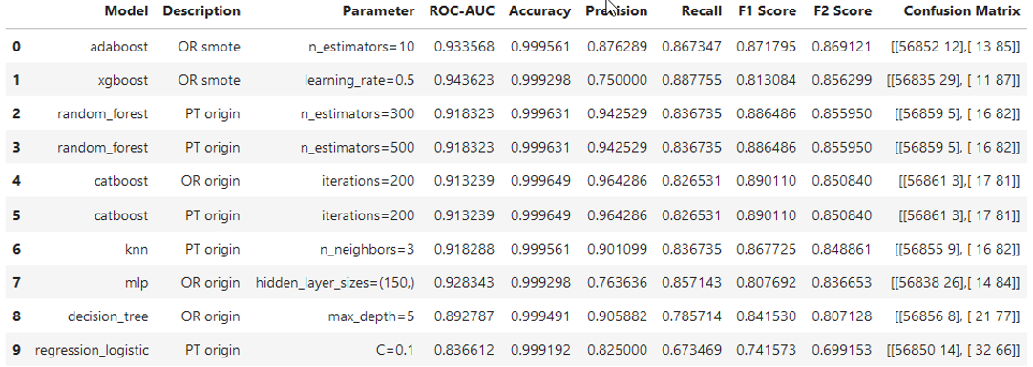
Final Ranking and Conclusions:
Eight algorithms have been trained, with one discarded: logistic regression due to low performance.
There are two groups of algorithms:
Models with F2 Score > 0.85: This is the default performance of the best algorithm by default. This group is formed exclusively by decision trees, all boosting algorithms, and random forest.
Models with F2 Score < 0.85: This group consists of KNN, MLP, and decision tree.

Slide 16
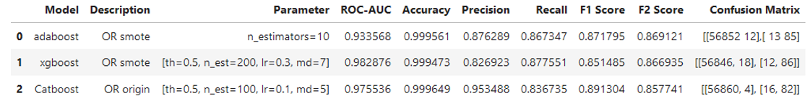
Ranking Final Fase Hiper Parámetros
CatBoost is rejected as it has the lowest F2 Score, resulting from having the highest number of false negatives.
AdaBoost:
Ideal for achieving a good balance between fraud detection and minimizing false alerts.
It is the most balanced solution between precision and recall.
XGBoost:
Ideal for maximizing fraud detection and minimizing false negatives.
It is the most effective solution to ensure the least amount of undetected fraud.
Higher ROC-AUC than AdaBoost, excellent ability to discriminate the fraud class.
END OF PRESENTATION.

